Slide 1
Incomplete Compensation for Self-Motion in the Visual Perception of Object Velocity during a Visual-Vestibular Conflict
Björn Jörges, Laurence R. Harris

Slide 2
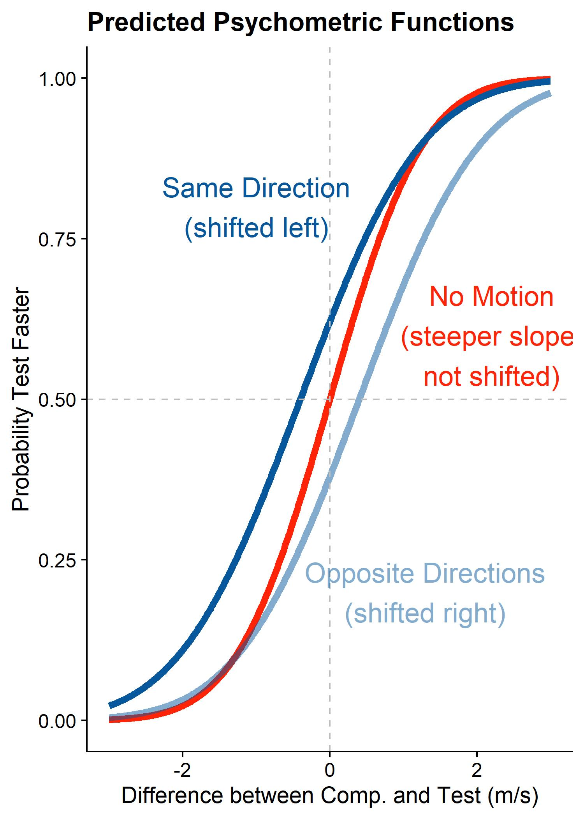
Background & Hypotheses
Estimating object motion requires estimating self-motion
Compensation for self-motion might be incomplete when self-motion is presented visually only
Object motion opposite to self-motion should be overestimated and vice-versa
Compensating for self-motion might incur precision cost

Slide 3
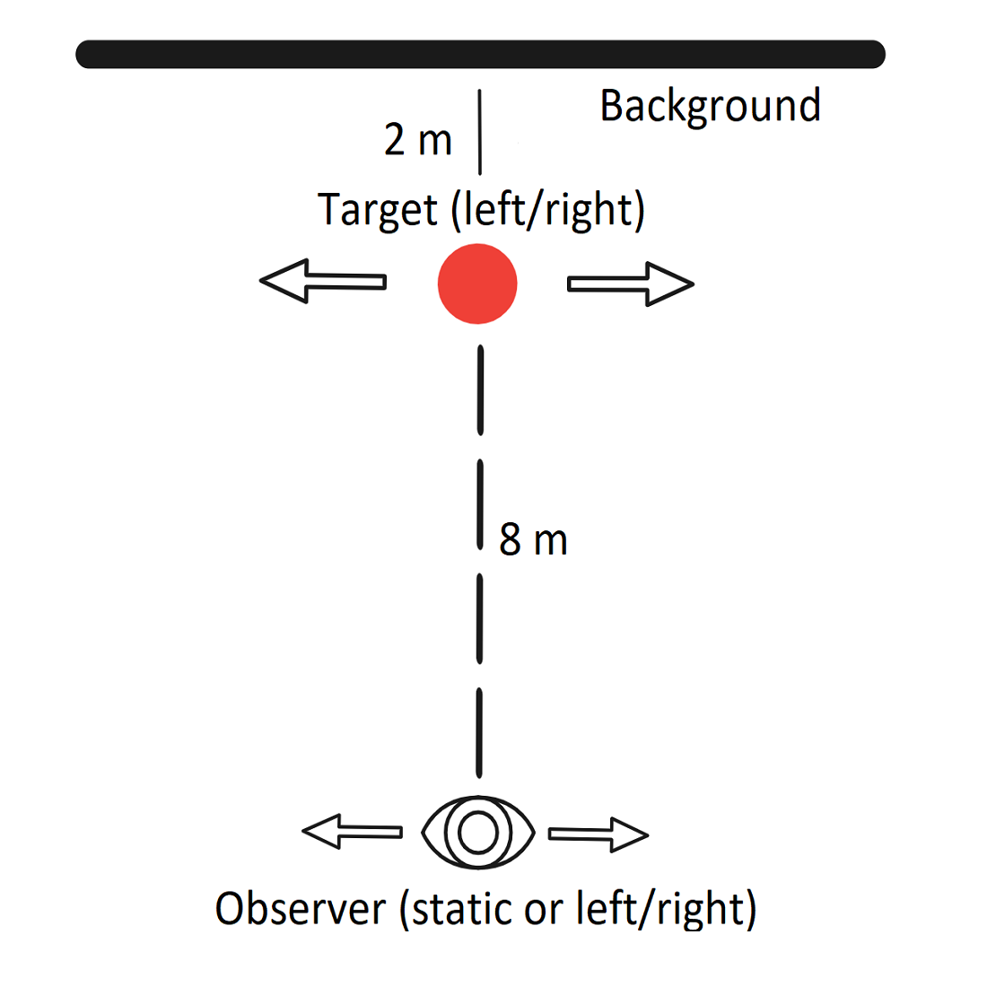
Stimulus
2 interval forced-choice task:
„Which is faster?“
Observer static, same direction as object, or opposite direction
PEST staircase

Slide 4
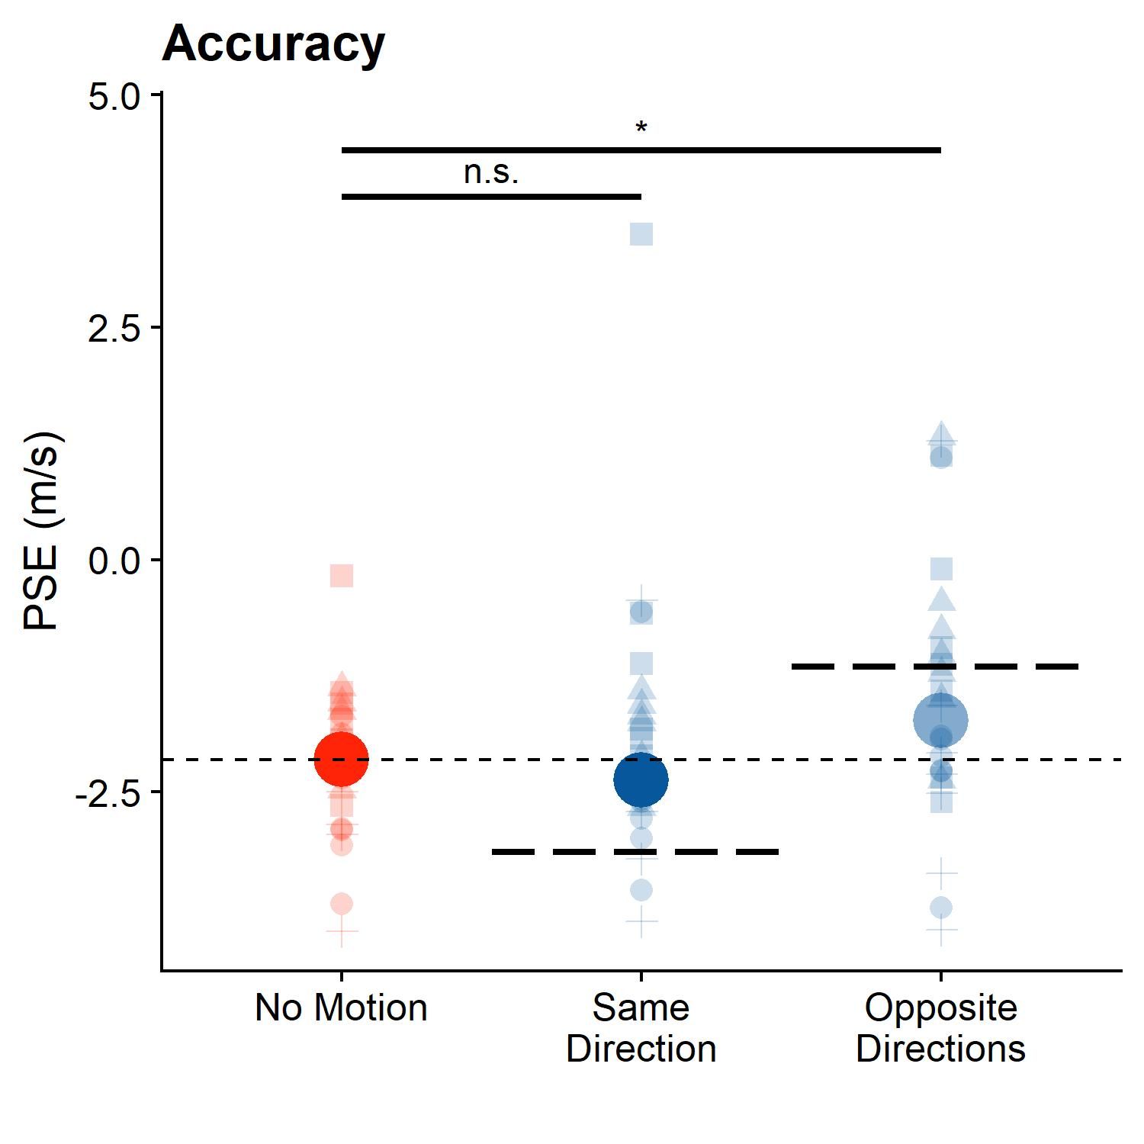
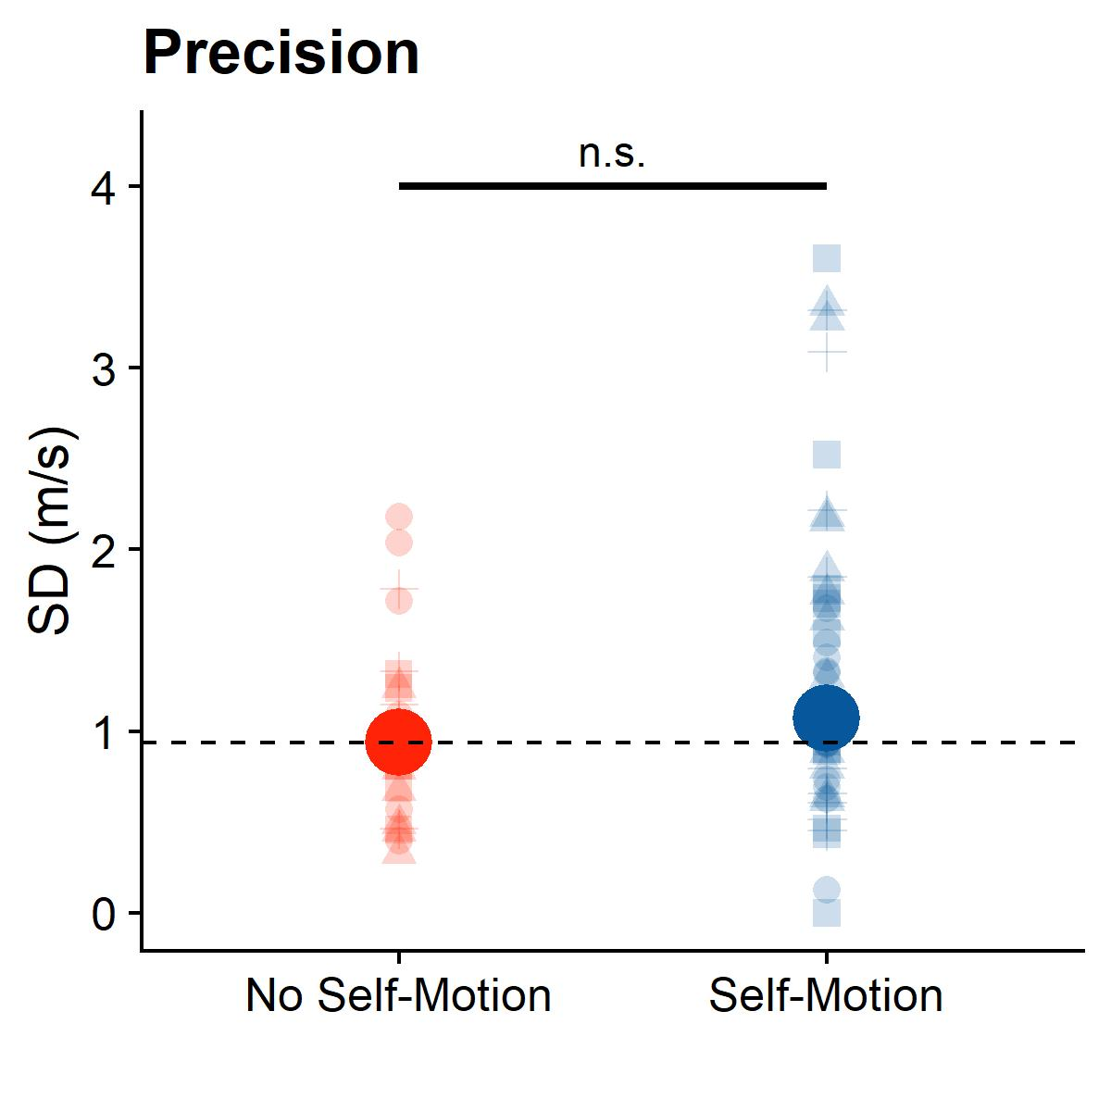
Results
0% compensation
100% compensation

Slide 5
Discussion
We compensate for visual self-motion ...
... nearly fully when it goes in the same direction as the target
... About 70% when self-motion and object motion go in opposite directions
This may come at a precision cost, but more data necessary

